Slide 1
ASYMPTOTIC ANALYSIS OF AdLGORITHMS
Presented By
Manish Rai
Assistant Professor, AIML-CSE

Slide 2
ALGORITHM
An algorithm is a procedure having well defined steps for solving a particular problem. Algorithm is finite set of logic or instructions, written in order for accomplish the certain predefined task.
It is not the complete program or code, it is just a solution (logic) of a problem, which can be represented either as an informal description using a flowchart or pseudo code.
The major categories of algorithms are given below:
Sort: algorithm developed for sorting the items in certain order.
Search: algorithm developed for searching the items inside a data structure.
Delete: algorithm developed for deleting the existing element from the data structure. Insert: algorithm developed for inserting an item inside a data structure.
Update: algorithm developed for updating the existing element inside a data structure.
Notes:
Program-formal approach syntax check code logic and informal means writternin eng language

Slide 3
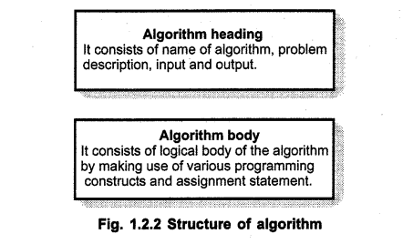
An algorithm should have the following characteristics −
• Clear and Unambiguous: Algorithm should be clear and unambiguous. Each of its steps should be clear in all aspects and must lead to only one meaning.
• Well-Defined Inputs: If an algorithm says to take inputs, it should be well defined inputs.
• Well-Defined Outputs: The algorithm must clearly define what output will be yielded and it should be well-defined as well.
• Finite-ness: The algorithm must be finite, i.e. after performing required operation it should terminate.

Slide 4
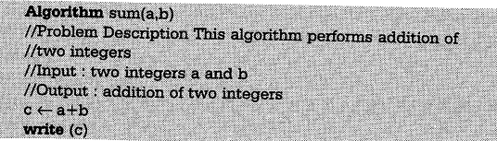
Specification of Algorithim
There are various ways by which we can specify an Algorithm
Using Natural Language
For eg Write a Algorithim to perform Addition of two Numbers
step 1 Read the number say a
step 2 Read the number say b
step 3 Add the two numbers and stored the result in a variable c
step4 Display the result
Pseudocode- it is a combination of Natural Language and programming language Constructs. This Specification is more useful from implementation point of view

Slide 5
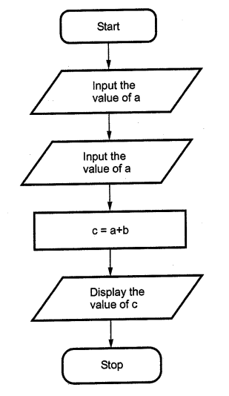
Flow Chart

Slide 7
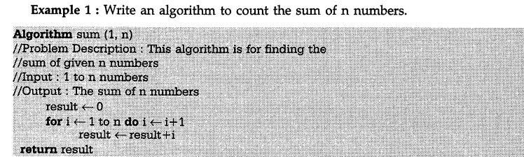

Slide 8
Asymptotic Analysis
Time complexity: It is a way of representing the amount of time needed by a program to run to the completion.
Space complexity: It is the amount of memory space required by an algorithm, during a course of its execution. Space complexity is required in situations when limited memory is available and for the multi user system.
It evaluate the performance of the algorithm in terms of its input size.
It measure how does the time or space taken by an algorithm increase with the input size.
Using the asymptotic analysis, we can easily conclude about the average case, best case and worst case scenario of an algorithm.
Worst case: It defines the input for which the algorithm takes the huge time.
Average case: It takes average time for the program execution.
Best case: It defines the input for which the algorithm
takes the lowest time.
Notes:
Asymptotic anlayis – find running time of an alg using mathematical eg arr[]=[1,2,3,4] x=4 linear search

Slide 9
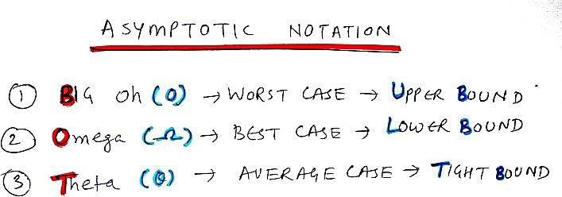
Notes:
Loweb bound running time of an alg

Slide 10
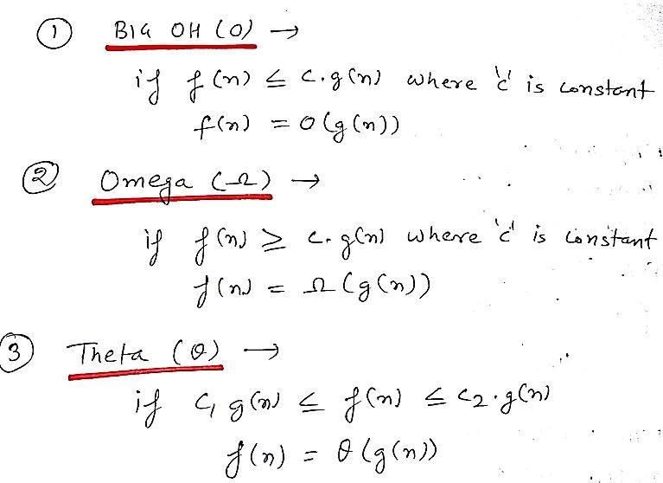

Slide 11
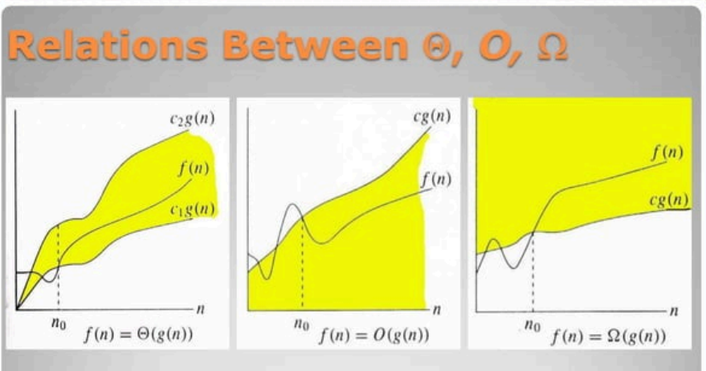

Slide 12
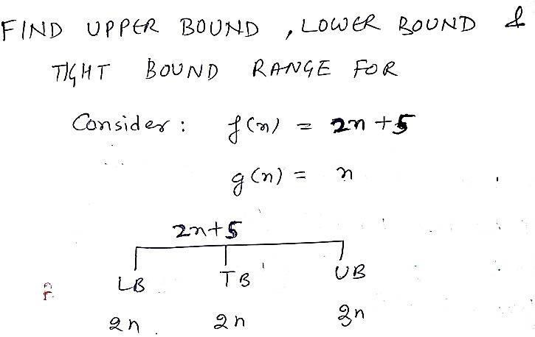
Notes:
Gn- highest order of n is fn ub=lb+1

Slide 13
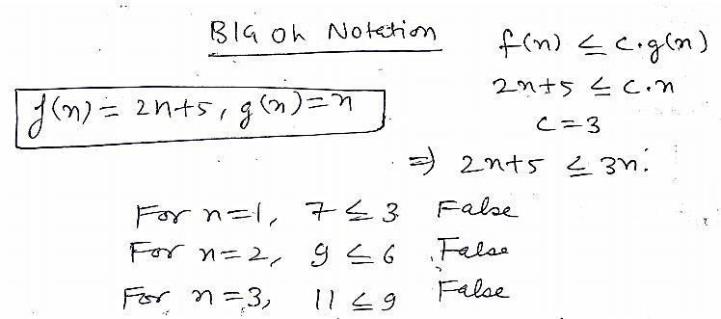
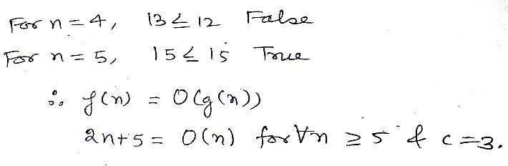

Slide 14
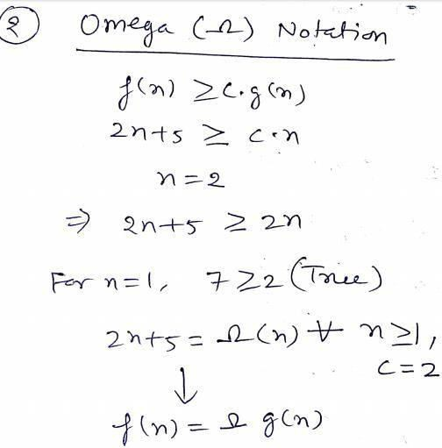
Notes:
Lowet bound fn= big omega of gn for all values of n>=1 and c=2

Slide 15
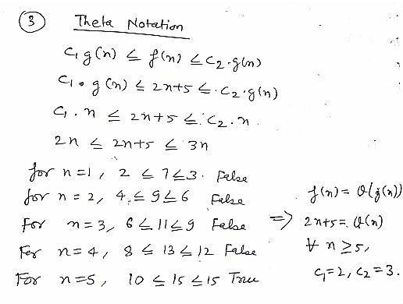
Notes:
Range of values

Slide 16

Asymptotic Notation
Asymptotic notations are the mathematical notations used to describe the running time of an algorithm when the input tends towards a particular value or a limiting value.
For example: In bubble sort, when the input array is already sorted, the time taken by the algorithm is linear i.e. the best case.
But, when the input array is in reverse condition, the algorithm takes the maximum time (quadratic) to sort the elements i.e. the worst case.
When the input array is neither sorted nor in reverse order, then it takes average time. These durations are denoted using asymptotic notations.
There are mainly three asymptotic notations: Theta notation, Omega notation, and Big-O notation.

Slide 17
F(n)=27n²+16n Evaluate its Big(O) Notation

Slide 18
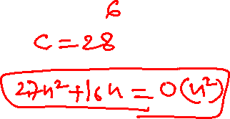
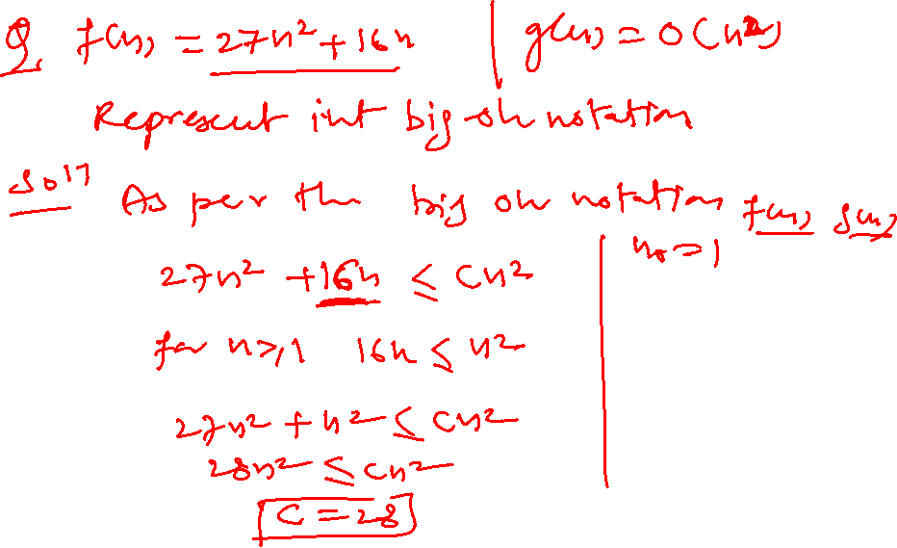

Slide 19
F(n)=27n²+16 Evaluate its Big(O) Notation

Slide 20
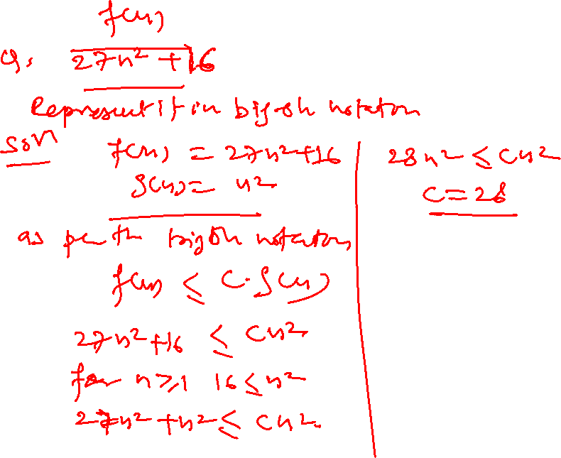

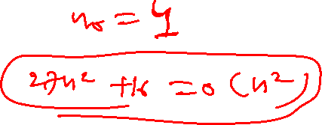

Slide 21
F(n)=4n³+2n+3 Evaluate its Big(O) and omega Notation

Slide 22
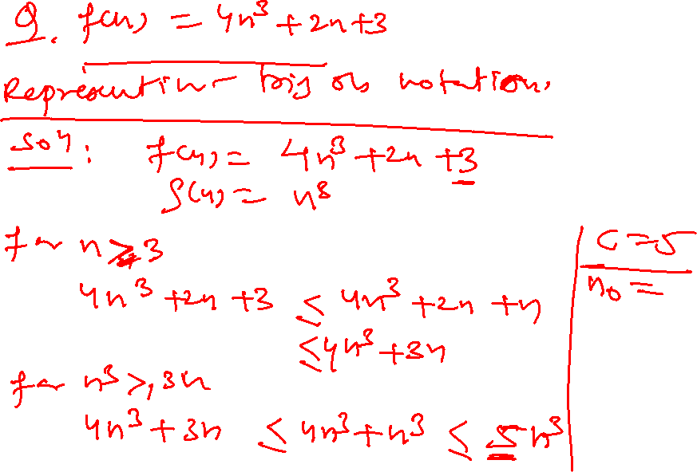

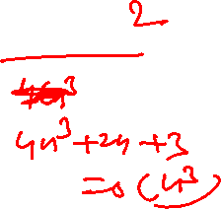


Slide 23
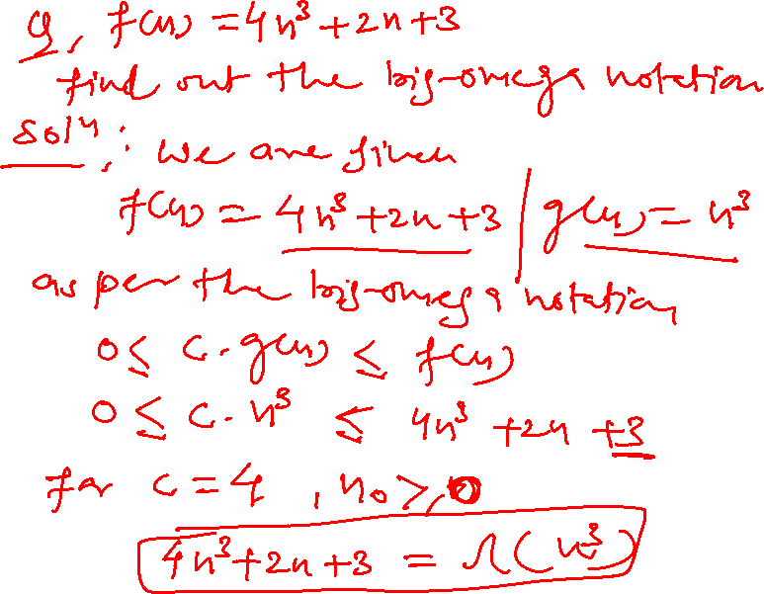

Slide 24
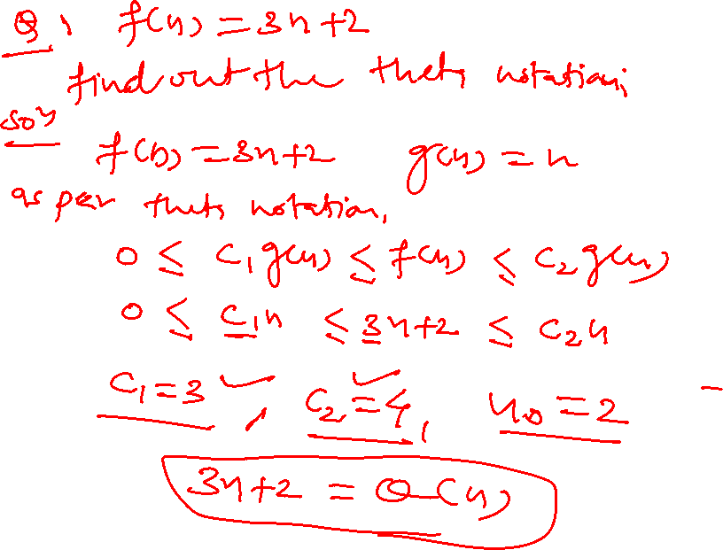

Slide 25
F(n)=2n+3 Evaluate its omega (π) Notation

Slide 26
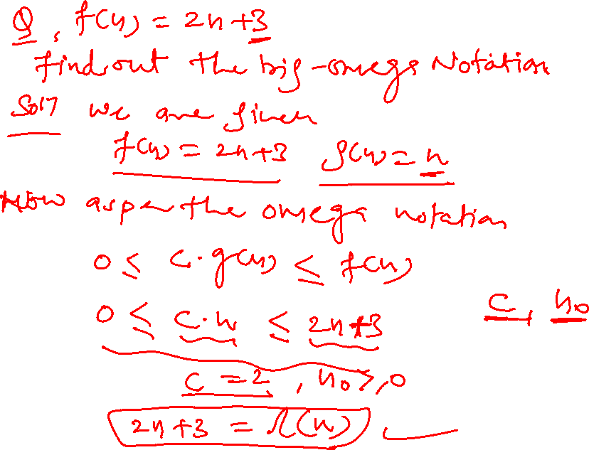

Slide 28
Fn=7n+5 find its Theta Notation

Slide 29
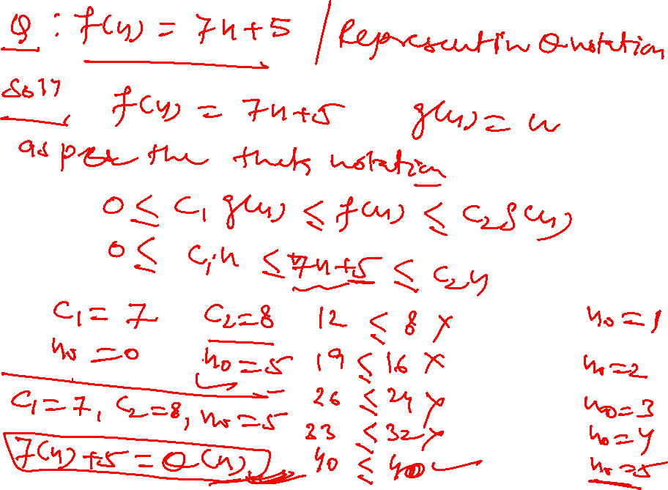

Slide 30
Example
for(i=0; i<n; i++)
{
statement;
}
Notes:
N+1,n 2n+1 time On

Slide 31
Example
for(i=n; i>0; i--)
{
statement;
}
Notes:
N+1,n On

Slide 32
Example
for(i=1; i<n; i=i+2)
{
statement;
}
Notes:
i=1,3,5,7,9 n/2 O(n) degree of polynomial

Slide 33
Example
for(i=1; i<n; i=i*2)
{
statement;
}
Notes:
Log2n How i progresses:
First iteration: i = 1
Second iteration: i = 2
Third iteration: i = 4
...
After k iterations, i = 2^k.
Stopping Condition:
The loop stops when 2^k ≥ n.
This means k = log₂(n).
Time Complexity:
The number of iterations (value of P) is proportional to log₂(n).
Thus, this loop runs in O(log n) time.

Slide 34
Example
for(i=n; i>=1; i=i/2)
{
statement;
}
Notes:
O(Logn) Time Complexity of a loop is considered as O(Logn) if the loop variables is divided / multiplied by a constant amount

Slide 35
Example
for(i=1; i<n; i++)
{
statement;
}
for(j=1; j<m; j++)
{
statement;
}
Notes:
O(m+n)

Slide 36
Example
for(i=0; i<n; i++)
{
for(j=1; j<n; j=j*2)
statement;
}
Notes:
N,logn = nlogn

Slide 37
Example
for(i=0; i<n; i++)
{
for(j=0; j<n; j++)
{
statement;
}
}
Notes:
n+1, n *(n+1), n*n= 2n^2+2n+1 On^2

Slide 38
Frequency Count Method (Example)
Algorithm Add(A,B,n)
{
for(i=0; i<n; i++)
{
for(j=0; j<n; j++)
{
C[i,j] = A[i,j] + B[i,j]
}
}
}
Notes:
Addition of two matrices were A &b are two matrices nis the size of matrc n+1, n*(N+1) ,n =n+1+n^2+n+n*n=n^2+3n+1= O(n^2) time complexity space
Space= A=n^2 B=n^2 C=N^2 I,jn=1 3n^2+3 = 0n^2

Slide 39
Frequency Count Method
Algorithm Sum(A, n)
{
s = 0;
for(i=0; i<n; i++)
{
s = s + A[i];
}
return s;
}
Notes:
SUM OF ALL THE ELEMENTS IN THE ARRAY time 1,n+1,n,1=2n+3=On time space = A=n,n=5 so 1,s=1,i=1 =n+3 Higher order is On

Slide 40
Frequency Count Method (Example)
Algorithm Multiply(A, B, n)
{
for(i=0; i<n; i++)
{
for(j=0; j<n; j++)
{
C[i,j] = 0;
for(k=0; k<n; k++)
{
C[i,j] = C[i,j] + A[i,k] * B[i,j];
}
}
}
}

Slide 41
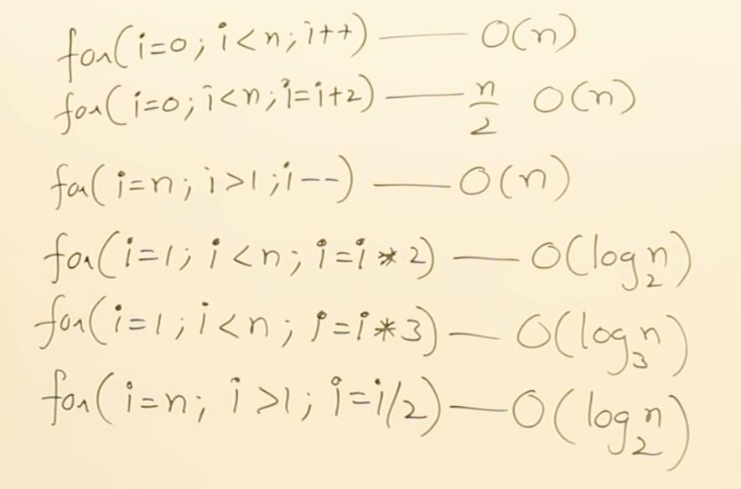
Observations

Slide 42
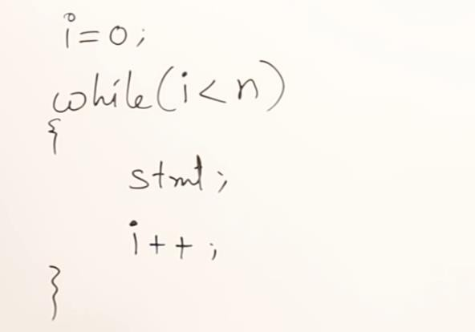
Example of While
Notes:
1,n+1,n,n 3n+2 On

Slide 43
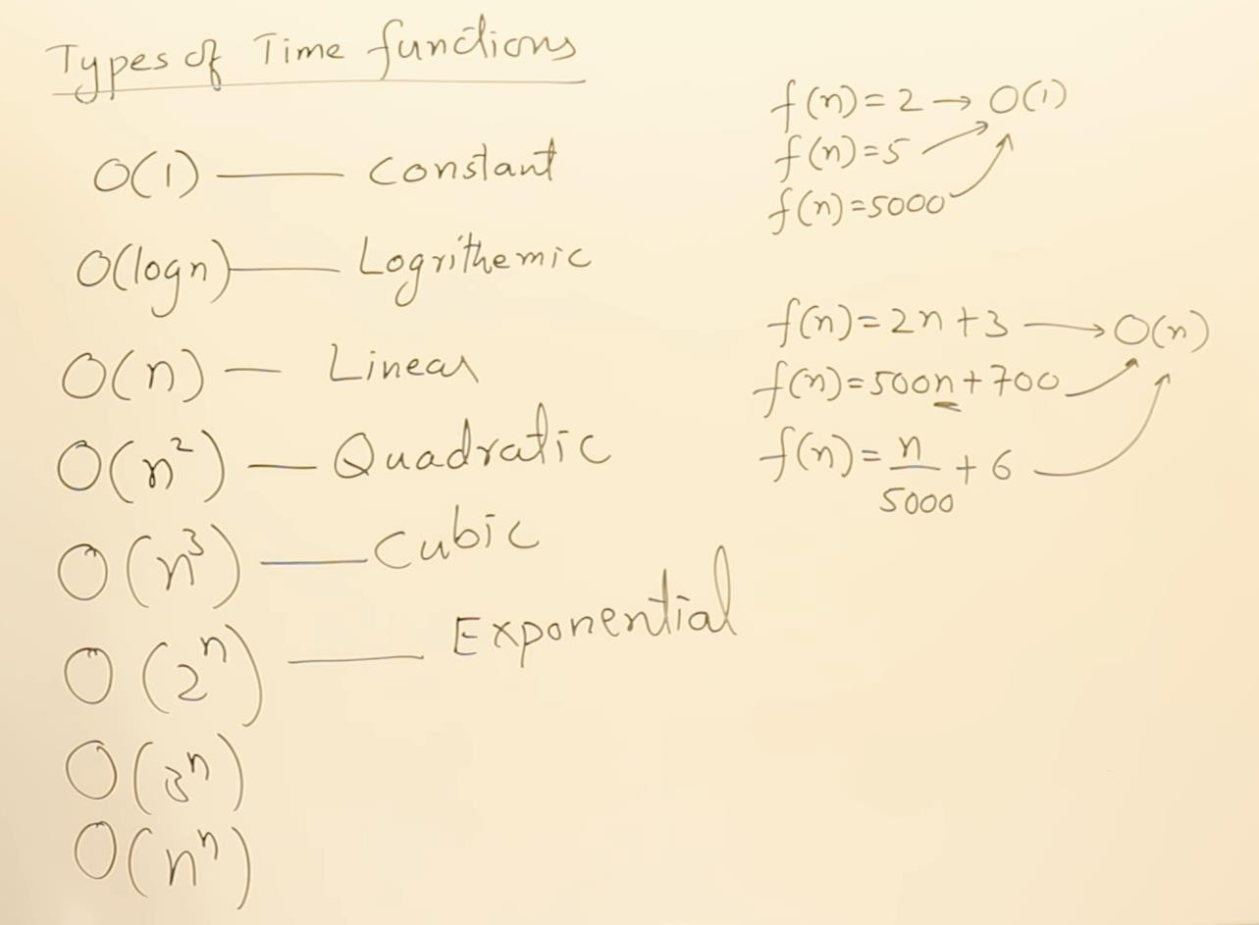


Slide 44
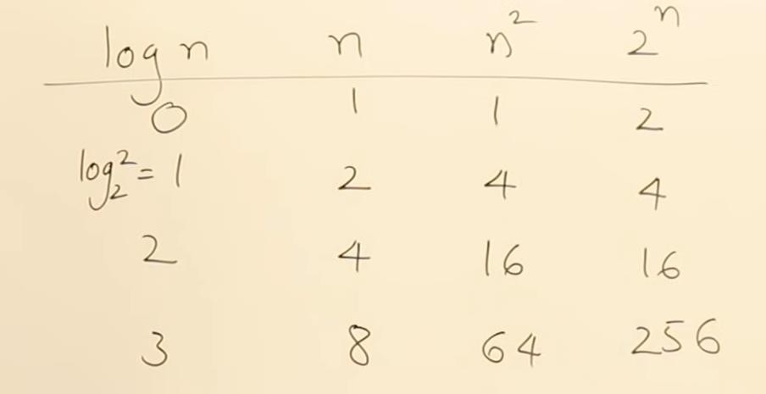
Compare Class of Functions

Slide 45
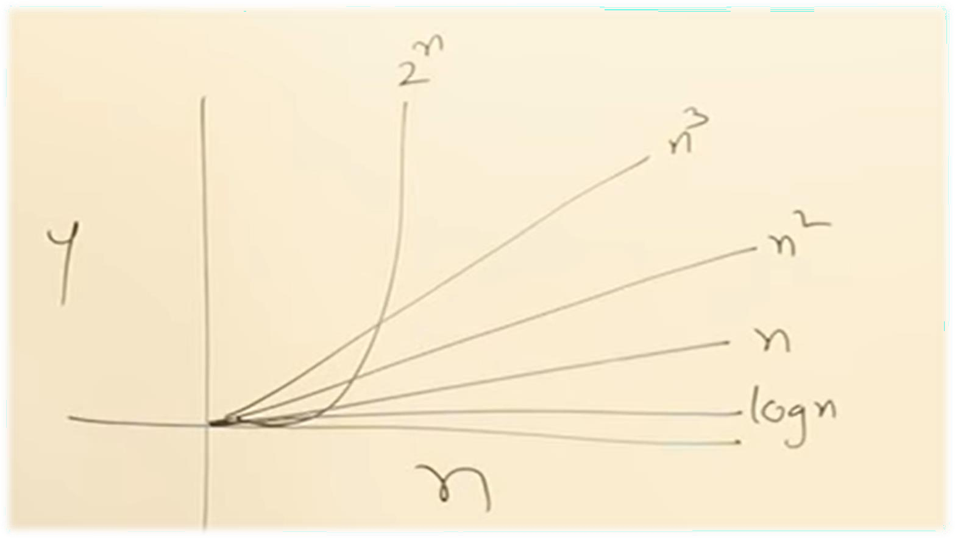
Compare Class of Functions

Slide 46
- COMPLEXITIES
O(1) – Constant Time Constant time means the running time is constant, it’s not affected by the input size. (Loop Running constant amount of times)
O(log n) – Logarithmic Time Algorithm that has running time O(log n) is slight faster than O(n). Commonly, algorithm divides the problem into sub problems with the same size. Example: binary search algorithm, binary conversion algorithm
O(n) – Linear Time When an algorithm accepts n input size, it would perform n operations.
O(n log n) – Linearithmic Time This running time is often found in "divide & conquer algorithms" which divide the problem into sub problems recursively and then merge them in n time. Example: Merge Sort algorithm.
O(n²) – Quadratic Time Look Bubble Sort algorithm!
O(n³) – Cubic Time It has the same principle with O(n²).
O(2^{n}) – Exponential Time It is very slow as input get larger, if n = 1000.000, T(n) would be 2^1000.000. Brute Force algorithm has this running time.
O(n!) – Factorial Time THE SLOWEST => Example : Travel Salesman Problem (TSP)

Slide 47


#include <stdio.h> void main()
{
int i, n = 8;
for (i = 1; i <= n; i++) {
printf("Hello Word !!!");
}
}
#include <stdio.h> int main()
printf("Hello World");
TIME COMPLEXITY–
TIME COMPLEXITY
for(i=0; i < N; i++)
{
for(j=0; j < N;j++)
{
statement;
}
}
for(i=0; i < N; i++) { statement; }
TIME COMPLEXITY
Notes:
In asymptotic notation constant not count

Slide 48

#include <stdio.h> void main()
{
int i, n = 8;
for (i = 1; i <= n; i++) {
printf("Hello Word !!!");
}
}
#include <stdio.h> int main()
printf("Hello World");
TIME COMPLEXITY– O(1)
TIME COMPLEXITY – O(1)
for(i=0; i < N; i++) { statement; }
TIME COMPLEXITY – O(N)
for(i=0; i < N; i++) {
for(j=0; j < N;j++) { | O(N²)
statement; } }

Slide 49


int count=0,N;
for(i=0;i<N*2;i++){ for(j=0;j<i/3;i++){ for(k=0;k<j*j;k++){ count++;
}
}
}
for (int i = 1; i <=m; i += c) {
// some O(1) expressions }
for (int i = 1; i <=n; i += c) {
// some O(1) expressions }

Slide 50
int count=0,N; --------(1)
for(i=0;i<N*2;i++){ ------ >0(n)
for(j=0;j<i/3;i++){ for(k=0;k<j*j;k++){ count++;
}
}
}
0(n/3)
0((n*n)/3)
Here we are using the for loop so that 0(n*(n/3)*(n*n)/3) so that 0(n^4)
for (int i = 1; i <=m; i += c) {
// some O(1) expressions } for (int i = 1; i <=n; i += c) {
// some O(1) expressions } O(m+n)

Slide 51





for (int i = 1; i <=n; i *= c) {
for (int i = n; i > 0; i /= c) {
// Here c is a constant greater than 1
for (int i = 2; i <=n; i = pow(i, c)) { // some O(1) expressions }
//Here fun is sqrt or cuberoot or any other constant root
for (int i = n; i > 1; i = fun(i)) { // some O(1) expressions }

Slide 52





is divided / multiplied by a constant
amount.
for (int i = 1; i <=n; i *= c) {
// some O(1) expressions } for (int i = n; i > 0; i /= c) {
// some O(1) expressions }
O(LogLogn) Time Complexity of a loop is considered as O(LogLogn) if the loop variables is reduced / increased exponentially by a constant amount.
// Here c is a constant greater than 1
for (int i = 2; i <=n; i = pow(i, c)) { // some O(1) expressions }
//Here fun is sqrt or cuberoot or any other constant root for (int i = n; i > 1; i = fun(i)) { // some O(1) expressions }

